Slide 2
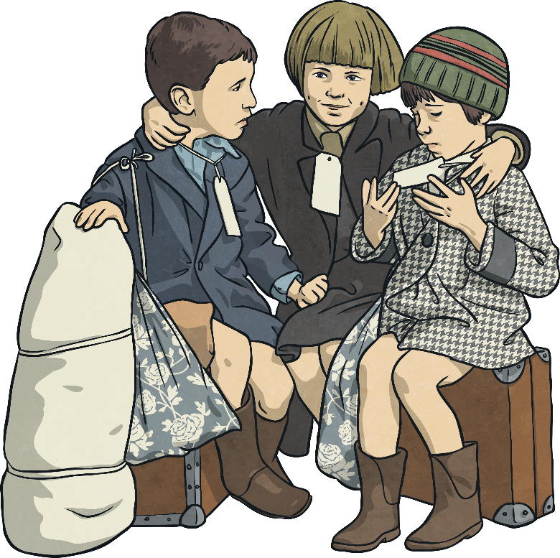
Read the extract carefully…
Evacuation
During World War II, many people were evacuated from the cities to the countryside, where it was believed they would be safer from bombing. In total, over 3.5 million people were evacuated during the war.
Most of the evacuees were children but other evacuees included mothers with very young children, pregnant women, disabled people and teachers and helpers to look after the children.
Evacuation happened in distinct waves, with the first wave of evacuations beginning on the 1st September 1939, two days before Britain officially declared war on Germany. Other waves were at the start of the Battle of Britain in June 1940 and at the start of the Blitz in September 1940.

Slide 3
On evacuation day, children travelled with their teacher or helper by train to their destination. They had to wear an identity label and take their gas mask, ration book, identity card and food for the journey. Many children also took a suitcase containing clothes and other personal items.
When they reached their destination, billeting officers were responsible for arranging for children to stay with host families. For many children, this involved being selected from a line by their host. This was an upsetting experience for some children, who felt unwanted or rejected.
Many children were evacuated to countryside towns and villages in Britain but some were evacuated overseas and lived with host families in places as far away as Australia and Canada.

Slide 4
Describe two ways that the text gives the impression that evacuation was a large-scale operation. Use evidence from the text to support your answer. [3 marks]
To earn all three marks, you need to explain two ways that the text shows evacuation as a big thing which affected a lot of people, giving evidence from the text to support at least one of them.
Remember, this question is about both retrieving information and inferring about the size or length of the evacuation from the information given.

Slide 5
The acceptable points you could have given were that…
AP1
A lot of people were evacuated.
AP2
Teachers and helpers were required to look after the children.
AP3
The evacuation occurred in distinct waves.
AP4
Children were required to wear identity labels.
AP5
Children were sent to different countries around the world.
Think about what can be inferred from the above points.
Why might evacuation had to have happened in waves?
Why wouldn’t people immediately know the name of each child?
Why couldn’t all of the children stay in the UK?
Remember: To earn all three marks, you need to describe two ways that the text makes evacuation look like a large-scale operation and give evidence from the text about at least one of them.

Slide 6
Some three-mark example answers are:
AP1
A lot of people were evacuated.
Evacuation is made to sound large-scale because a lot of people were involved. The text says that over 3.5 million people were evacuated. It was such a big event that not everyone could be evacuated at the same time.
[AP1 + evidence and AP3]
AP2
Teachers and helpers were required to look after the children.
The text says that children were required to wear identity labels. This must have been because there were so many children that no one could keep track of them. Also, not every child could stay in the UK because there were so many of them, so they were sent to places as far away as Australia and Canada.
[AP4 + evidence and AP5 + evidence]
AP3
The evacuation occurred in distinct waves.
AP4
Children were required to wear identity labels.
AP5
Children were sent to different countries around the world.
Did you earn all three marks?

