Slide 1

Key Stage 2 SATs
Guide for parents and carers

Slide 2
What are the tests like?
First and foremost, at Leighswood we focus on your child’s well-being, ensuring they feel confident and try their best in every challenge, not this year but also as they move to Y7 and beyond.
In preparation, through the Autumn Term, all the children have tried out the different styles of tests, building up their stamina and confidence.
At the beginning of the Spring Term, all the children had a go at what a real week of SATs to see what it would look like, sitting on their own tables, sitting in different rooms and again building up stamina and confidence. They were brilliant and impressed us with their recall, their confidence and maturity.
Before Easter the children will have another go at trying out the SAT’s.
All these opportunities are really useful for they children to understand what they need to do and for teachers to find where they can help them, ready for May.
You will have lots of opportunity to see the different styles of questions, in lessons and we will practice lots of times so you feel confident.
Do I need a pencil case? What happens if my pencil breaks?
Everything you need will be on your table and if your pencil breaks, an adult will be there to give you another one to write with.
I don’t think I can answer the questions, will somebody help me?
If you find a question tricky, you can leave it out and go to the next one, You might not be able to answer them all, that’s OK. You will be brilliant, just try your best.

Slide 3
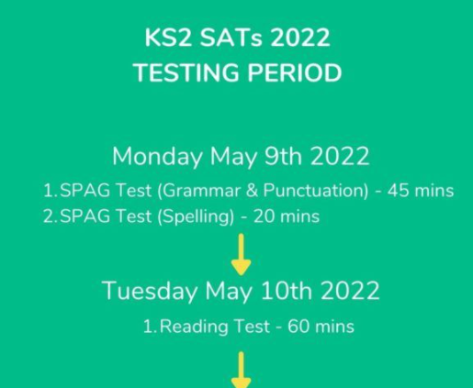
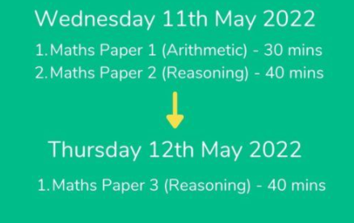
When are the KS2 SATs 2022 and what do you need to know?
The dates for the KS2 SATs normally run over a one week period.
In 2022 the KS2 SATs will take place between Monday 9th May 2022 – Thursday 12th May 2022.
Over this period pupils will sit 6 different tests, with English normally taking place at the beginning of the week and maths at the end.

Slide 4
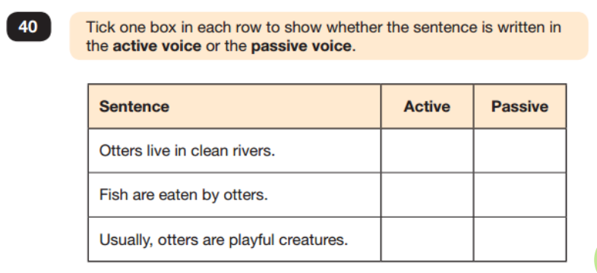
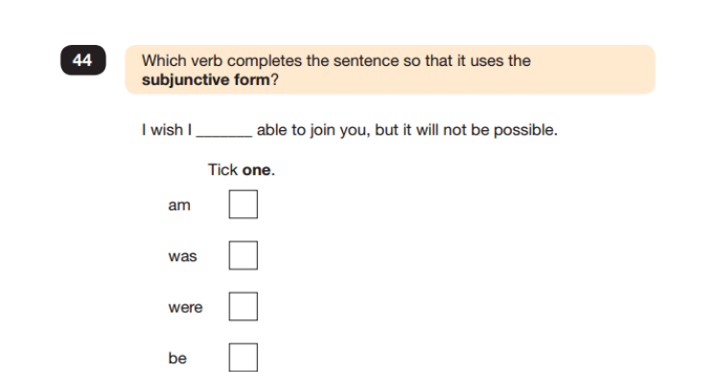
GRAMMAR, PUNCTUATION and SPELLING
A spelling test is administered containing 20 words, which lasts approximately 15 minutes.
A separate test is given on grammar, punctuation and vocabulary.
This test lasts for 45 minutes and requires short answer questions including some multiple choice.
Marks for these two tests are added together to give a total for grammar, punctuation and spelling.

Slide 5
READING
The reading test consists of a single test paper with three unrelated reading texts. Children are given 60 minutes in total, which includes reading the texts and answering the questions.
• A total of 50 marks are available.
• Questions are designed to assess the comprehension and understanding of a child’s reading.
• During the reading paper, a child’s inference and deduction skills are thoroughly tested. They will also be expected to answer questions on authorial choices: explaining why an author has chosen to use particular vocabulary, grammar and text features.
• Some questions are multiple choice or selected response; others require short answers and some require an extended response or explanation.

Slide 6
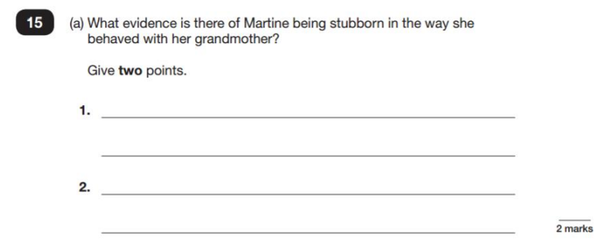
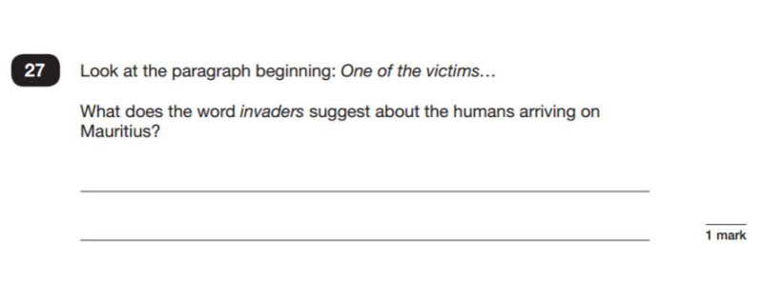

Slide 7
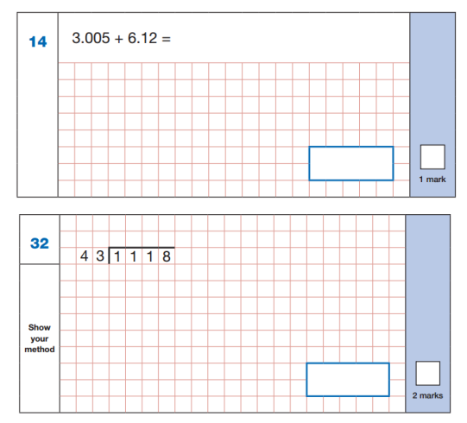
MATHEMATICS
Children will sit three tests: paper 1, paper 2 and paper 3.
• Paper 1 is for arithmetic lasting for 30 minutes, covering calculation methods for all operations, including use of fractions, percentages and decimals.
• Questions gradually increase in difficulty.
• Papers 2 and 3 cover problem solving and reasoning, each lasting for 40 minutes.
• Pupils will still require calculation skills but will need to answer questions in context and decide what is required to find a solution.

Slide 8
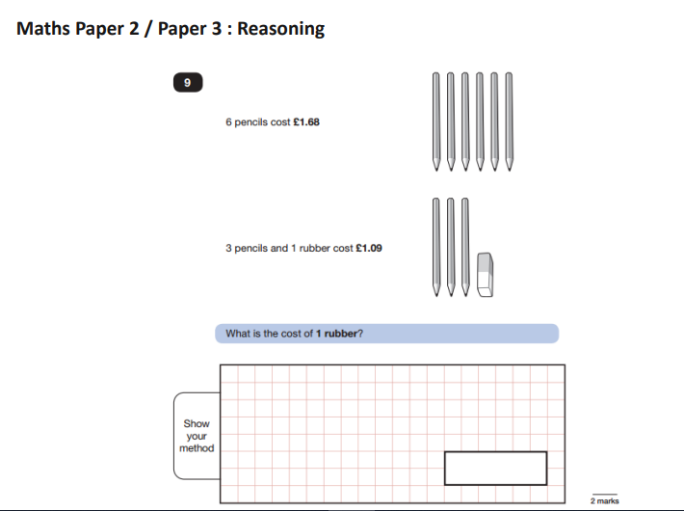
If 6 pencils are £1.68 then 3 will be £1.68 ÷ 2 = 84p
Therefore 1 rubber will cost
£1.09 – 84p = 25p
6p = £1.68
p = £ 1.68 ÷ 6 = 28
3p + r = £1.09
(28 x 3) + r = £1.09
The numbers used are small but you need to remember this is a two step problem and find the cost of 1 rubber. The pictures are always useful to use too.

Slide 9
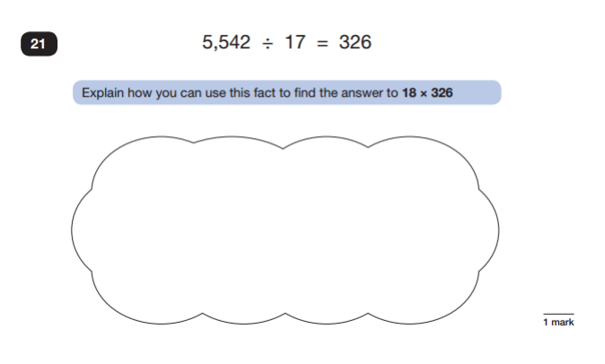
Switcher
If 5542 ÷17 = 326
Then I know that
326 x 17 = 5542
If 17 lots of 326 = 5542
Then 18 lots of 326 would be 5542 + 326

Slide 10
How can adults at home help?
• First and foremost, support and reassure your child that there is nothing to worry about and they should always just try their best. Praise and encourage!
• Ensure your child has the best possible attendance at school.
• Support your child with any homework tasks.
• Reading, spelling and arithmetic (e.g. times tables) are always good to practise.
• Talk to your child about what they have learnt at school and what book(s) they are reading (the character, the plot, their opinion).
• Make sure your child has a good sleep and healthy breakfast every morning!

Slide 11
READING - an essential skill for life
Listening to your child read can take many forms.
• First and foremost, focus developing an enjoyment and love of reading. Talk about how important reading is in every day life.
• Enjoy stories together – reading stories to your child at KS1 and KS2 is equally as important as listening to your child read.
• Read a little at a time but often, rather than rarely but for long periods of time!
• Talk about the story before, during and afterwards – discuss the plot, the characters, their feelings and actions, how it makes you feel, predict what will happen and encourage your child to have their own opinions.
• Look up definitions of words together – you could use a dictionary, the Internet or an app on a phone or tablet.
• All reading is valuable – it doesn’t have to be just stories. Reading can involve anything: fiction, non-fiction, poetry, newspapers, magazines, football programmes and TV guides.
• Visit the local library - it’s free!

Slide 12
WRITING
Practise and learn weekly spelling lists – make it fun!
Presentation is key, good pen control is important for good joined handwriting
Encourage opportunities for writing such as letters to family or friends, shopping lists, notes or reminders, stories and poems.
• Write together – be a good role model for writing.
• Encourage use of a dictionary to check spelling and a thesaurus to find synonyms and expand vocabulary.
• Allow your child to use a computer for word processing, which will allow for editing and correcting of errors without lots of crossing out.
• Remember that good readers become good writers! Identify good writing features when reading (e.g. vocabulary, sentence structure and punctuation).
• Show your appreciation: praise and encourage, even for small successes!

Slide 13
MATHS is everywhere
Play times tables games.
• Play mental maths games including counting in different amounts, forwards and backwards.
• Encourage opportunities for telling the time.
• Encourage opportunities for counting coins and money; finding amounts or calculating change when shopping.
• Look for numbers on street signs, car registrations and anywhere else!
• Look for examples of 2D and 3D shapes around the home.
• Identify, weigh or measure quantities and amounts in the kitchen or in recipes.
• Play games involving numbers or logic, such as dominoes, card games, darts, draughts and chess.

Slide 14
What happens if my child is absent from school during this week?
All children need to attend school for SATs on the set day. It is a statutory requirement.
If your child is under the weather, please let us know and we will make arrangements for them to come in and take the test safely at the same time as all the other children in their class.
If a child is absent, we have to inform the statuary testing agency and the rest of the children have to wait to start the test until we have confirmation they have received the information.
Children who do not attend on the day, must remain in isolation from other children and not make contact with them until they have completed all the tests when they have returned to school.
They will not be allowed to have any contact with their peers in school until they have completed all the tests.
If your child is not in school on the day of the test, Parents/Carers must ensure that:
the content of the tests has remained confidential
the pupil has not been in contact with any pupils who have already taken the tests
the pupil has not had access to the test materials, for example via the internet or social media
the pupil is in a fit physical and mental state to take the tests, particularly in cases where the pupil is returning to school after an illness or injury
Head teachers may need to contact the pupil’s parents to confirm that the confidentiality of the tests has been maintained. If the head teacher is aware of any reason why these conditions cannot be confirmed, the pupil must not take the test. Instead, they should be marked as ‘Absent’ (A) on the test attendance register.
Failure to follow this guidance could result in a maladministration
If an individual pupil is absent on the rescheduled test date, the school can reschedule the test for that pupil again, if it is still within the timetable variation period for the affected test.
If a pupil is absent on the day of a test and does not return within 5 school days, the school must mark the pupil as ‘Absent’ (A) on the test attendance register.

